Slide 1
Lab 9: The Immune System, immunoassays and Blood Typing
Objectives:
Understand the relationship between nonspecific and specific defense
Understand the different cells that are involved in the immune response
The effect of HIV on the human immune system
Understand the different protocols used in an ELISA

Slide 2
Pre-Lab
1. List the 4 processes of nonspecific defense.
Physical Barriers
Inflammation
Natural Killer cells destroy foreign cells
Prevention of viral replication
2. List the 4 characteristics of specific immunity .
Specificity
Diversity
Memory
Self-tolerance
3. Which cells form a “bridge” between nonspecific defense and specific immunity? Macrophages
4. Name the effector cells for B cells. Name the effector cells for T cells. What are the functions of these various effector cells? See slide 6
5. Once lymphocytes are activated, effector cells are produced by 2 processes: clonal expansion followed by differentiation.

Slide 3
Pre-Lab (Continued)
6. What type of cells will cytotoxic T cells bind to and destroy? Abnormal, foreign, from tissue transplant, cancerous cells
7. What 2 proteins are involved in the binding process referred to in the previous question?
CD-8 protein, Class I MHC protein
8. The interaction between a helper T cell and either a B or T lymphocyte involves which proteins?
CD-4 protein
Class II MHC protein
9. What do the letters ELISA stand for? Very briefly describe the concept of an ELISA.
Enzyme linked immunosorbent assay

Slide 4
Nonspecific Defense
“Innate immunity”
Process: 1. Prevent entry → skin and mucous membranes
2. Inflammation→ histamines and cytokines
fever →pyrogens
Phagocytosis “cell eating”→ neutrophils, monocytes, macrophages and eosinophils
3. Destroy virus infected or cancerous cells→ NK Cells
4. Destroy bacteria→ Compliment proteins
Prevent replication→ Interferons
https://www.youtube.com/watch?v=HNP1EAYLhOs

Slide 5
Specific Defense
“Acquired immunity”
Process:
1. Specificity → Antigen receptor recognition
2. Diversity → Clonal expansion and differentiation
3. Memory → memory cells (2-3 days vs 10-14 days)
4. Self-Tolerance → Interaction between the CD8 and I MHC protein.

Slide 6
Immune Cells
 | B-Lymphocytes | T-Lymphocytes
Antigen Receptors | Membrane antibodies | T-Cell receptors
Effector Cells | Memory Cells- Reside in lymph nodes until the body is attacked by the antigen a 2nd time. (Secondary response occurs in 2-3 days vs. 10-14 days of the initial response)
 | Plasma Cells- Mark the antigen for destruction by phagocytosis or "cell eating" | Cytotoxic T-Cells- bind to abnormal/foreign cells w/ antigens. Essentially kills the cell by releasing chemicals that poke holes in cell membrane. (When this recognition fails it is considered a sign of an autoimmune disease.)
 |  | Helper T-Cells- activate various mechanisms in immune response (help to activate differentiation of B & T lymphocytes)
 |  | Regulatory (Suppressor) Cells- work to turn down or turn off various mechanisms in immune response.

Slide 7
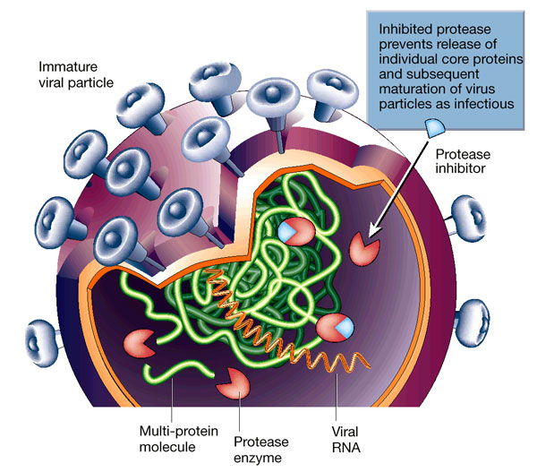
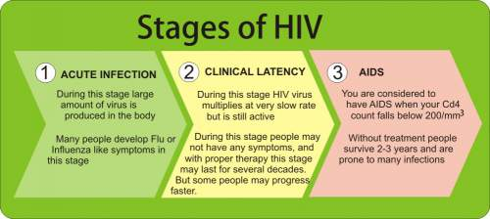
HIV
HIV is spread through bodily fluids
Helper T-cells-Remains dormant until activated
Test for the presence of antibodies (ELISA)

Slide 8
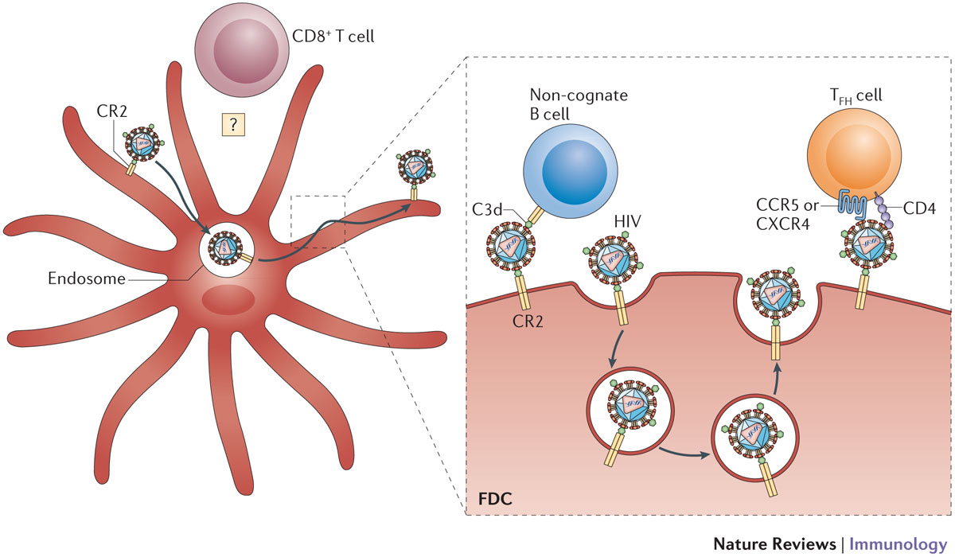
HIV-Helper T cell endocytosis

Slide 9
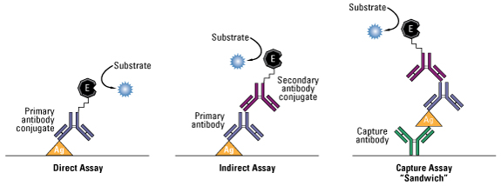
ELISA
https://youtu.be/RRbuz3VQ100

Slide 10
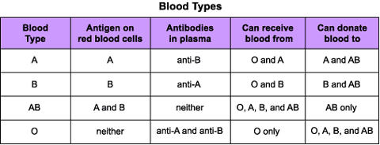
Blood Typing
Rh factor: either +/- depending on whether the antigens are present or not. RhoGAM protects against unborn child with opposite Rh factor.
https://www.youtube.com/watch?v=ttjn1jVACk8

Slide 11
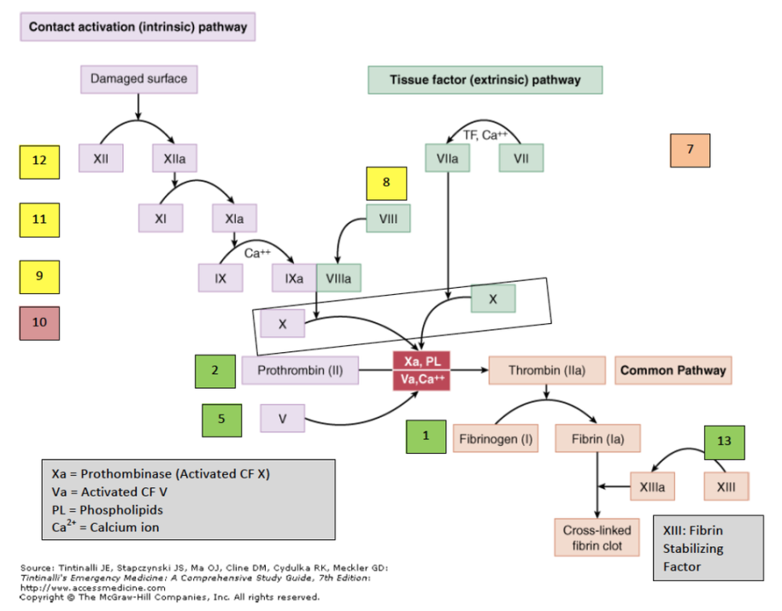
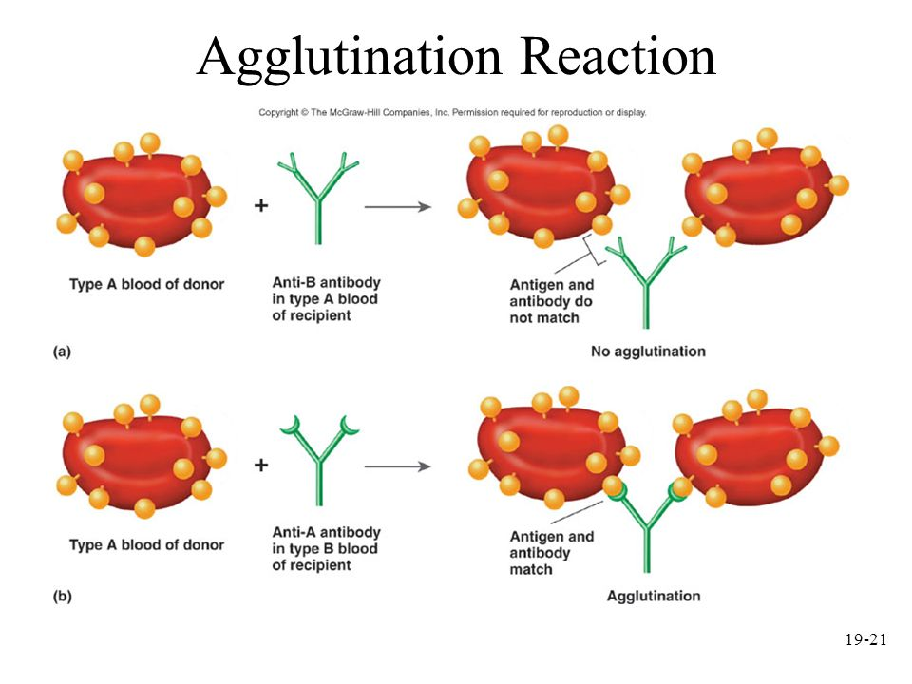
Agglutination vs. Coagulation
Agglutination
Coagulation
Note: Agglutination is a very simple reaction compared to the complex reaction involved in coagulation which involves intrinsic/extrinsic pathways.

Slide 12
Post lab

