Slide 1
Lab 8: Blood Characteristics
Blood Pressure
Hematocrit
Buffering Capacity
Clotting
Disease types

Slide 2
Pre-Lab
1. Flow of blood through the circulatory system is directly proportional to _pressure_ and is inversely proportional to _resistance_.
2. What is a typical resting blood pressure reading (systolic/diastolic)? 120/80
3. Which circuit of the circulatory system (systemic or pulmonary) is being assessed by a blood pressure reading using a cuff around the arm?
4. What is the mathematical relationship between cardiac output, heart rate, and stroke volume?
See slide 4

Slide 3
Pre-Lab (Cont.)
5. Given the relationship between heart rate and cardiac output, would an increase in parasympathetic release of acetylcholine at the heart increase or decrease cardiac output?
6. Which muscles are acting in “myogenic control” of local blood flow? Smooth muscle of arteriole
7. If someone says a solution has an acidic pH, they are not actually referring to the concentration of acids in the solution, but instead to the relatively high concentration of _H⁺_.
8. If you have a solution that contains a buffering system, and you add protons to the solution, what component of the buffering system will accept the protons?
Circle one: The weak acid or The weak base.
9. What disease has a variety of causes that can be distinguished by determination of the Mean Corpuscular Volume and the Mean Corpuscular Hemoglobin Concentration of blood. Anemia

Slide 4
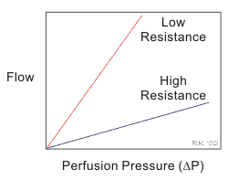
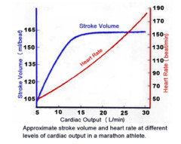
Variables involved in blood flow
Blood Flow
The rate at which blood flows through the vessels
Cardiac Output
The amount of blood pumped by each of the ventricles over time
Flow (ml/min) =
Pressure Difference (mm Hg)
Resistance
Cardiac Output (ml/min) = Heart Rate (beats/min) x Stroke Volume (ml/beat)

Slide 5
Blood Pressure & Heart Rate
Systolic maximal pressure created by ventricular contraction
Diastolic after ventricular contraction, lowest pressure
Normal resting blood pressure__________.
Process: involves the use of a stethoscope and a sphygmomanometer.
Normal resting heart rate _______
Tachycardia-elevated resting heart rate (>100beats/min)

Slide 6
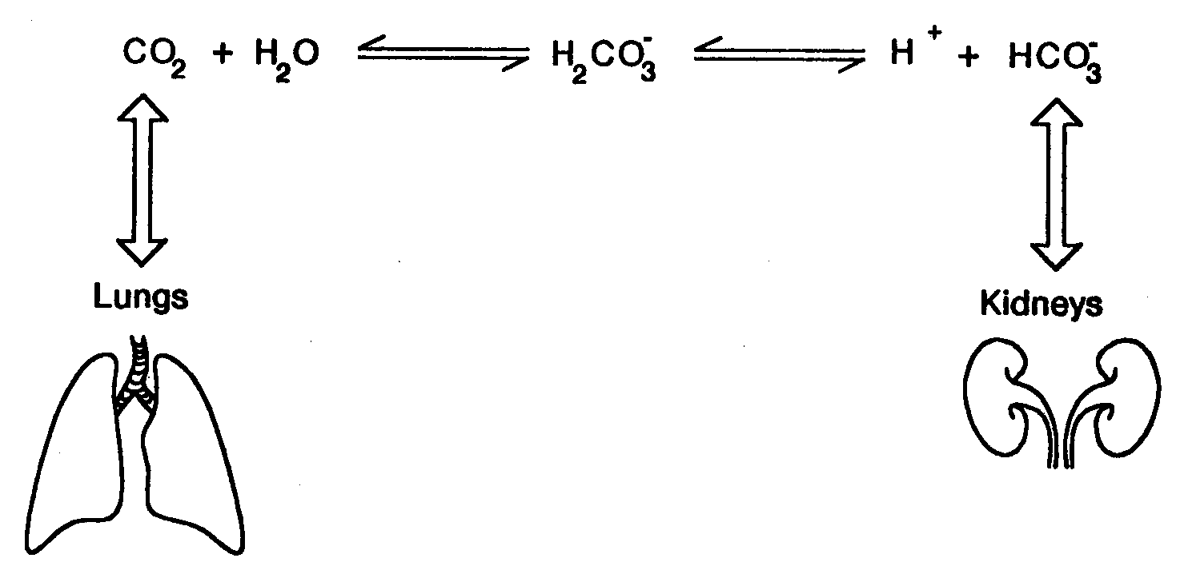
Buffering Capacity
The blood’s ability to maintain pH
The body has a narrow pH range 7.3-7.4
Bicarbonate
reaction

Slide 7
Activity 5: Determination of Hematocrit, Hemoglobin Concentration and Red Blood Cell Count
Centrifuge
MCV= hematocrit x 10
RBC (10⁶/mm³)
The measure of the average volume of each RBC
MCHC= hemoglobin (g/dl) x 100
hematocrit
The measure of the average amount of Hemoglobin found in each RBC
Microscope Count
Spec 20 Extrapolation
Centrifuge

Slide 8
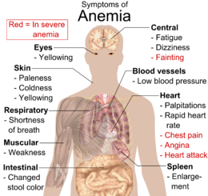
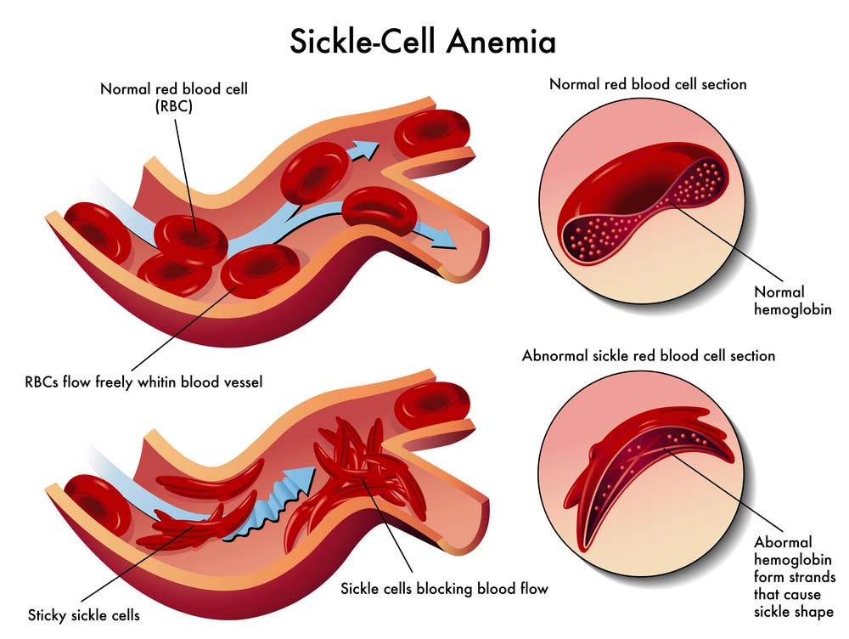
Anemia lowered ability of the blood to carry oxygen

Slide 9
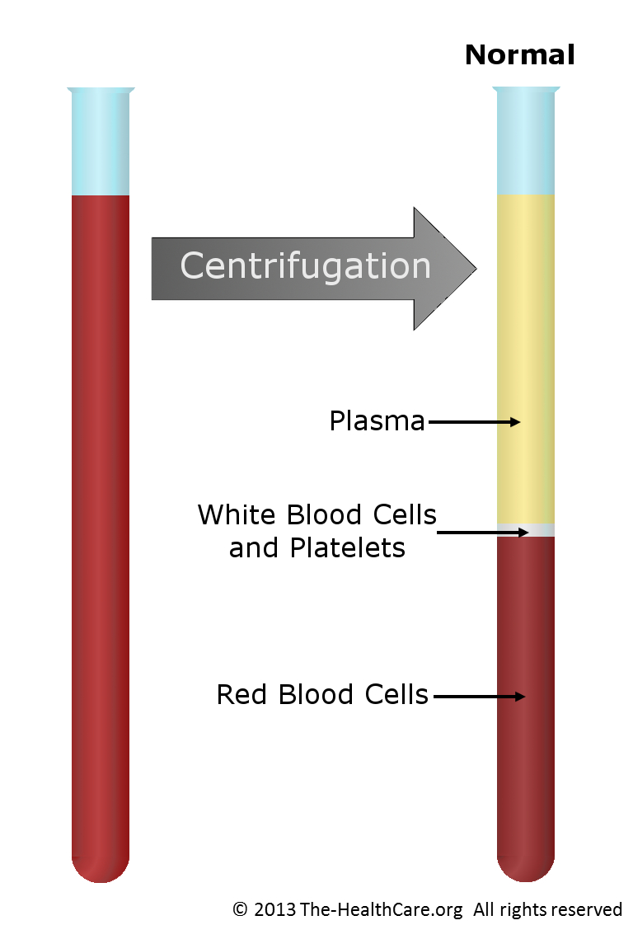
Hematocrit separating blood components
Normal Hematocrit Values
Female | 37-47%
Male | 42-52%

Slide 10
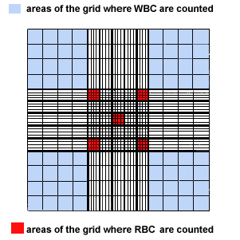
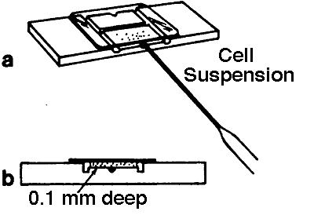
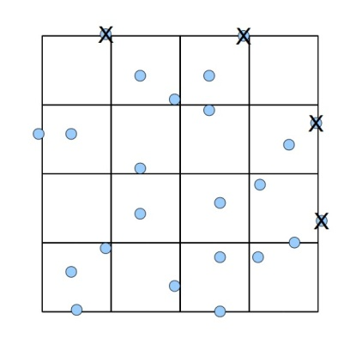
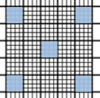
Red Blood Cell Count
1
2
3
4
5
In order to find the volume of an individual RBC we need to count the RBC’s to get an average of how many there are in a certain volume of blood.

Slide 11
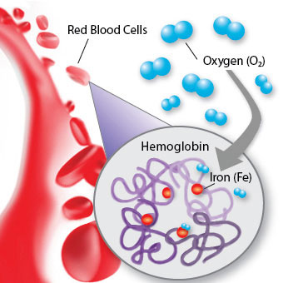
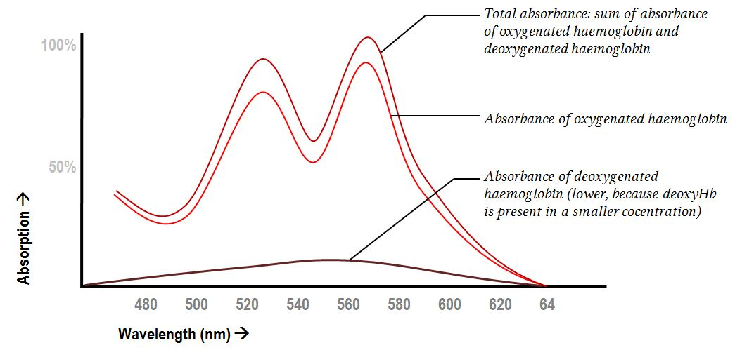
Hemoglobin Concentration
Cuvet # | Hemoglobin Conc (g/dl) | Absorbance @ 540 nm
1 | 0 | 0
2 | 6 | 0.17
3 | 12 | 0.34
4 | 18 | 0.54
5 (your cuvet) |  | 0.40

Slide 12
Activity 5: Determination of Hematocrit, Hemoglobin Concentration and Red Blood Cell Count
Centrifuge
MCV= hematocrit x 10
RBC (10⁶/mm³)
The measure of the average volume of each RBC
MCHC= hemoglobin (g/dl) x 100
hematocrit
The measure of the average amount of Hemoglobin found in each RBC
Microscope Count
Spec 20 Extrapolation
Centrifuge

Slide 13
Post Lab

