Slide 1
LAB 7
ELECTROCARDIOGRAM

Slide 2
OBJECTIVES
ANATOMY OF THE HEART
ELECTRICAL ACTIVITY OF THE HEART
RECORDING THE ELECTRICAL ACTIVITY OF THE HEART WITH AN ELECTROCARDIOGRAM
DEVIATIONS IN THE NORMAL ECG PATTERN

Slide 3
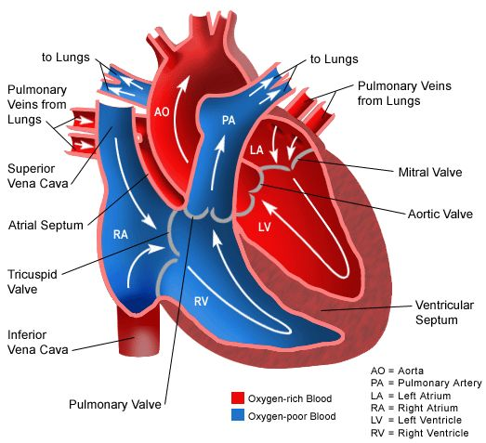
ANATOMY OF THE HEART

Slide 4
ELECTRICAL ACTIVITY OF THE HEART
PACEMAKER CELLS: they initiate action potentials and establish the heart rhythm. These are responsible for triggering contractions. They are located in the SA NODE and AV NODE.
CONDUCTION FIBERS: transmit action potentials through the heart in a highly coordinated manner.

Slide 5
ELECTRICAL ACTIVITY OF THE HEART
1. Action potential is initiated very rapidly in the SA Node. Impulses travel to the AV node by way of internodal pathways (conduction fibers) and interatrial pathways.
2. The impulse is conducted to cells of the AV node less rapidly (AV nodal delay).
3. From the AV node, the impulse travels through the bundle of His.
4. the signal travels only a short distance through the bundle of His before it splits into left and right bundle branches, which conduct impulses to the left and right ventricles.
5. From the bundle branches, impulses travel through an extensive network of branches (Purkinje fibers). The impulses travel through the rest of the myocardial cells.
https://www.youtube.com/watch?v=RYZ4daFwMa8

Slide 6
RECORDING THE ELECTRICAL ACTIVITY OF THE HEART WITH AN ELECTROCARDIOGRAM
ECG is the process of recording the electrical activity of the heart over a period of time using electrodes on the skin.

Slide 7
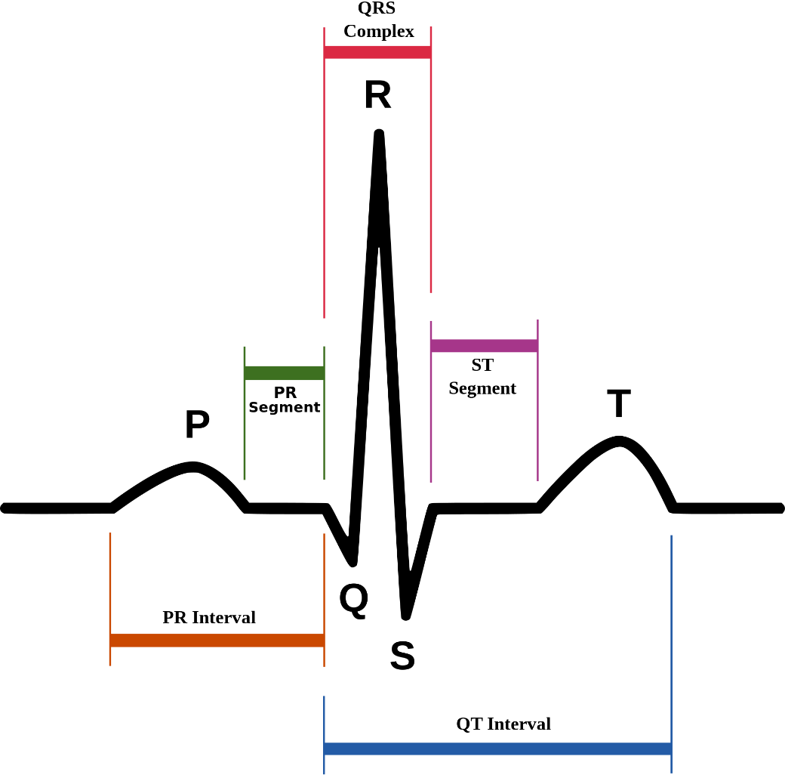
ECG

