Slide 1
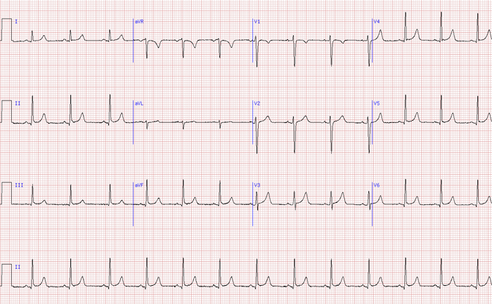
Lab 8: Electrocardiogram

Slide 2
Pre-Lab
1. Where do the electrical impulses generated by the heart’s electrical conduction system begin? SA node
2. What happens next after a cell has completed depolarization? They repolarize
3. What is the period between the end of ventricular repolarization and the start of depolarization? T-Q segment
4. What does the isoelectric line represent? Zero potential

Slide 3
Pre-Lab (Cont)
5. On a normal ECG, what does the P wave represent? Atrial depolarization
6. Why is Willem Einthoven important to a discussion of electrocardiography? He came up with a way to measure the deflection of the electrical signal through the heart.
7. What is indicated by the QT interval? Ventricular systole
8. The main direction of depolarization as it travels through the ventricles is called the R Wave Axis.

Slide 4
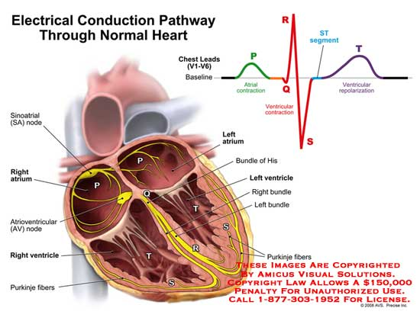
Electrical pathway through the heart
Sa node→ Av node→ Bundle of His→ L/R bundle branches → Purkinje fibers

Slide 5
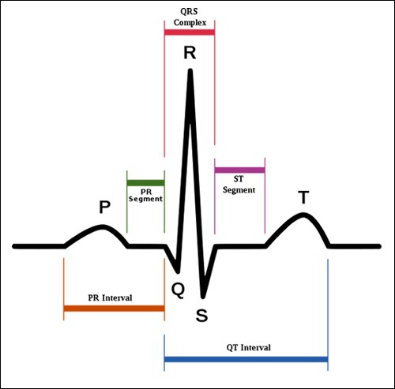
P wave- atrial depolarization QRS complex- Ventricular depolarization T wave- Ventricular repolarization
ECG

Slide 6
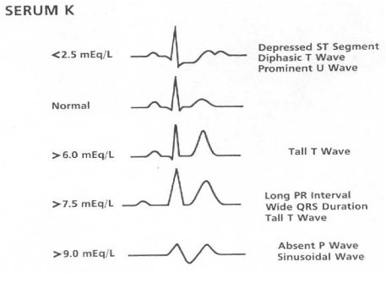
Abnormal ECG Rhythms
* Check out the website
below. Really helpful
in considering ECG
abnormalities.
http://www.ambulancetechnicianstudy.co.uk/rhythms.html#.V3yEyY-cGUk

Slide 7
Examples of Abnormal ECG’s
The R wave represents the depolarization of the ventricles. A split R wave indicates that the ventricles are not depolarizing simultaneously as they should. This could indicate damage to one of the bundle branches.
The PR interval represents the time it takes for the impulse to travel from the atria to the ventricles. An exaggerated PR interval might indicate something is wrong with the AV node, such as a blocked blood vessel in the myocardial tissue between the ventricles.

Slide 8
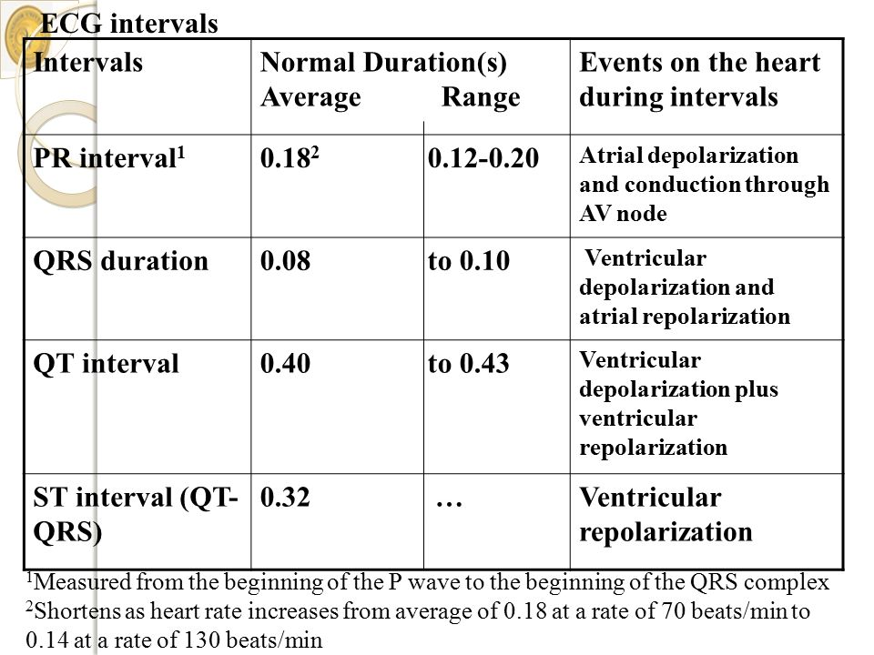
Normal Interval Values
Waves | Normal Amplitudes
P | <2.5mm
T | <5mm
*Amplitudes for the QRS complex have a wide variance with age, and gender.

Slide 9
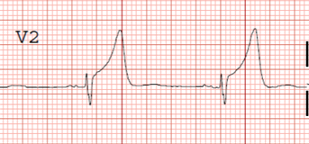
Bonus Questions
1.)Compare your measured amplitudes with the normal amplitudes found on slide 8. Are they in the normal ranges? What could be a reason to see a normal variance in amplitude?
Exaggerated QRS complex
2.)What is happening during the QRS complex and why might it take longer than usual?

Slide 10
Post Lab

