Slide 1
LAB 6: MUSCLE PHYSIOLOGY

Slide 2
UNDERSTAND VOCABULARY KEY WORDS
Motor point
Motor unit
Myofibrils
Actin
Myosin
Sarcomeres
Muscle twitch
Threshold stimulus
Recruitment
Muscle fatigue

Slide 3
MOTOR POINT
SENSITIVE SPOTS WHICH ELICIT A VERY STRONG RESPONSE
THESE ARE FOUND ON THE BELLY OF THE MUSCLE WHERE THE NERVE ENTERS
ONE OF THE MUSCLE YOU WILL BE STIMULATING TODAY IS ABDUCTOR DIGITI MINIMI
THE MOTOR POINT FOR THE ABDUCTOR DIGITI MINIMI IS FOUND ON THE MEDIAL SIDE OF THE HAND, JUST DISTAL TO THE WRIST

Slide 4
MOTOR UNIT
FUNCTIONAL UNIT IN SKELETAL MUSCLES
EACH MOTOR UNIT CONSISTS OF A SINGLE SOMATIC MOTOR NEURON THAT BRANCHES TO INNERVATE ONE OR MORE MUSCLE FIBERS BUT EACH MUSCLE FIBER IS INNERVATED BY ONLY ONE MOTOR NEURON.
FIGURE 11.14 IN THE TEXTBOOK

Slide 5
MYOFIBRILS
A skeletal muscle is made up of many muscle fibers (muscle cells) that run the length of the muscle.
Each muscle fiber contains many myofibrils, which are bundles of actin and myosin which are the fiber’s contractile machinery.

Slide 6
ACTIN/ MYOSIN/SARCOMERES
ACTIN
Thin filaments in muscle fibers
MYOSIN
The contractile protein found in thick filaments
SARCOMERES
The fundamental repeating units that make up myofibrils
FIGURE 2 AND 3 IN LAB MANUAL
http://www.youtube.com/watch?v=CepeYFvqmk4

Slide 7
STRUCTURE OF A SARCOMERE

Slide 8
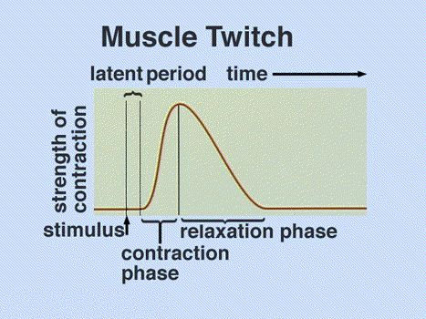
MUSCLE TWITCH
Latent Period: the time between the action potential
in the muscle fiber and the onset of contraction.
Contraction Phase: the onset of contraction until the
Force (tension) of the muscle reaches the maximum
(calcium levels increasing).
Relaxation Phase: tension decreases because reuptake
of calcium is greater than release.
The mechanical response of a muscle cell or whole muscle to a single action potential

Slide 9
MUSCLE TWITCH
Latent Period (the events that result in a contraction take time)
Depolarization
Release of calcium ions into the sarcoplasm from the sarcoplasm reticulum
Attachment of myosin crossbridges to actin
Tightening of elastic elements within the muscle cell
Two kinds of muscle twitches: Isometric and Isotonic
Difference is based on whether the muscle shortens in length or not.

Slide 10
ISOMETRIC VS ISOTONIC
The muscle changes length (shorten) The muscle contracts without shortening
in length

Slide 11
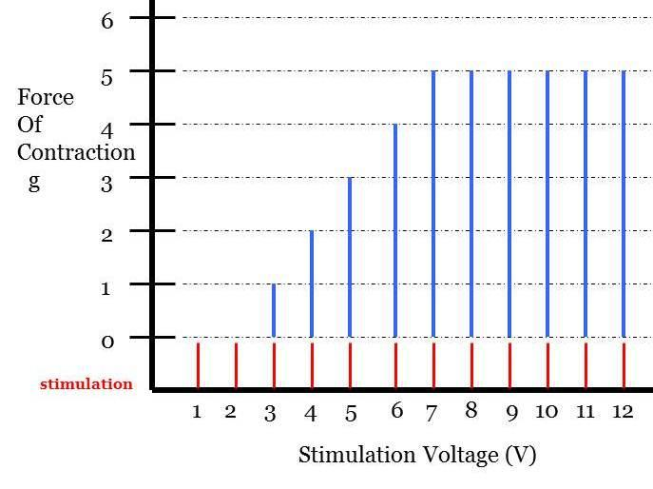
THRESHOLD
The minimum voltage necessary to generate an action potential in the muscle fiber and produce a contraction

Slide 12
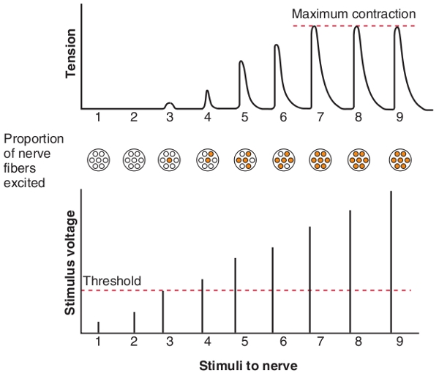
RECRUITMENT
The process of increasing the number of motor units that are active
As the stimulus strength increases, more motor units are stimulated to contract, generating a stronger force of contraction.

Slide 13
VARIABLES THAT ALTER THE FORCE THAT CAN BE GENERATED BY A MUSCLE
Size/ number of fibers
Type of fibers
Starting Length
Size of Load

Slide 14
MUSCLE FATIGUE
When a muscle fiber is frequently stimulated to contract, the tension produced eventually decreases.
Muscle fatigue is influenced by the type of exercise
High intensity exercise (Ex. Weight lifting), fast glycolytic fibers are recruited. These have a larger diameter which makes them stronger but are the quickest to fatigue.
In low intensity (Ex. Long duration exercise), slow oxidative and fast oxidative fibers are used. Slow oxidative fibers have smaller diameter which means less strength but are the slowest to fatigue. While the fast oxidative fibers have an intermediate strength as well as intermediate resistance to fatigue.
The order of stimulation goes slow oxidative fibers, fast oxidative fibers and fast glycolytic fibers.

