Slide 1
Lab 6: Muscle Physiology
Objectives:
Study and understand the following vocabulary: motor point, motor unit, threshold stimulus, and summation, recruitment and tetanus

Slide 2
Pre-Lab
1. What is a sarcomere? What is it made up of? A labeled drawing would be good here.
Smallest functional contractile unit made up of actin and myosin.
2. List the four factors that contribute to the latent period of a muscle twitch.
Depolarization of the sarcolema and the t-tubules
Release of the calcium ions into the sarcoplasm from the S.R.
Attachment of myosin cross bridges to actin
Tightening of elastic elements within the muscle cell
3. What is an isometric contraction? What is an isotonic contraction?
Isometric –same length (tension generated but no work done)
Isotonic- Shortening of the muscle (load is overcome)
4. What is recruitment? How does recruitment occur? See slide 8

Slide 3
Pre-Lab (cont)
5. Differentiate between fast glycolytic, fast oxidative, and slow oxidative fibers in terms of strength of contraction, resistance to fatigue, and order of stimulation.
Fiber Type | Contraction Strength | Resistance to fatigue | Order of stimulation
Fast glycolytic | Largest diameter Strongest | Quickest to fatigue Inefficient glucose breakdown | #3
Fast oxidative | Intermediate | Intermediate | #2
Slow oxidative | Smallest Diameter Least strength | Slowest to fatigue | #1

Slide 4
Pre-Lab (continued)
6. What is the relationship between the length of the latent period of shortening and the weight of the load being moved by a muscle?
As the weight of the load increases the longer the latent period
7. What is summation? Explain what is happening inside the muscle fiber to cause increased force to develop.
The force of an individual muscle fiber increases, the muscle fiber is stimulated to contract more frequently causing the twitches to add together. (See slide 10)
8. What two factors determine the amount of force generated by a whole muscle?
The number of muscle fibers contracting (recruitment)
and the individual force produced by each muscle fiber.

Slide 5
Motor point and motor unit
Where nerve and muscle meet

Slide 6
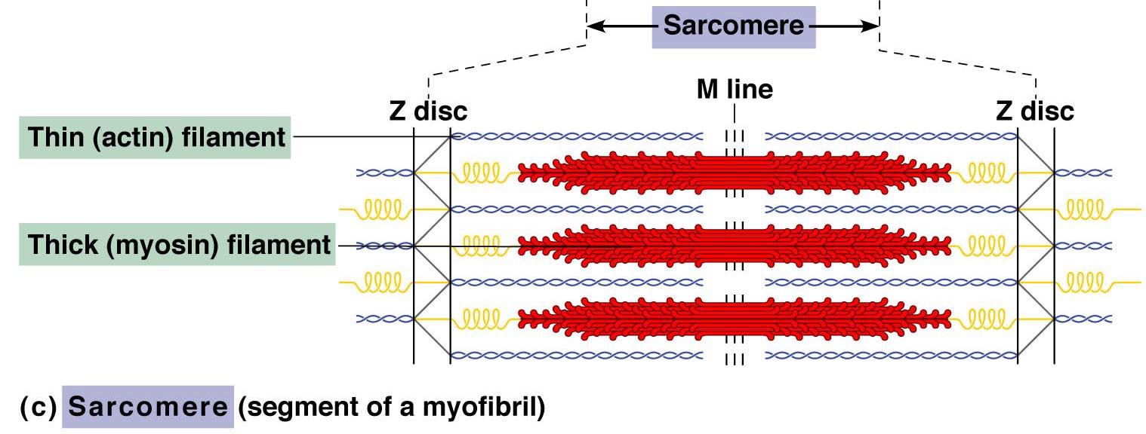
Sarcomere
https://www.youtube.com/watch?v=0kFmbrRJq4w

Slide 7
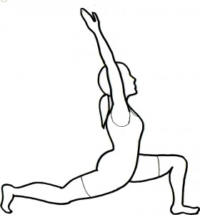
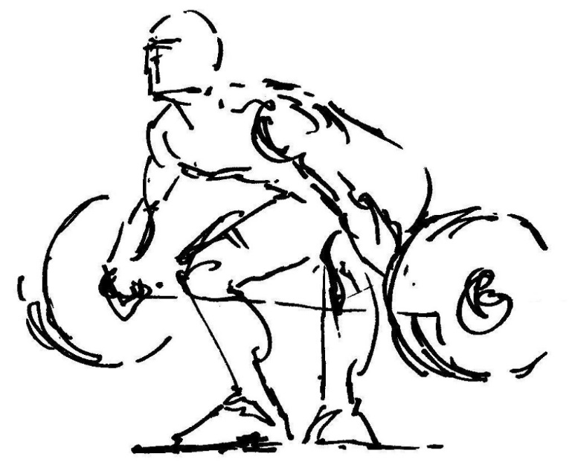
Isometric vs Isotonic
Isometric Contraction
Same length
Isotonic Contraction
Muscle shortening
W= F x D

Slide 8
Muscle Twitch
Latent Period
Contraction Phase
Relaxation Phase

Slide 9
Threshold Stimulus

Slide 10
Recruitment
Adding more muscle fibers to overcome the load

Slide 11
Summation
The force of an individual muscle fiber increases to overcome the load

Slide 12
How does load effect the contraction?
Weight (g) | Twitch Amplitude | Work (W=F • D)
10 | 0.04 | 0.4
20 | 0.04 | 0.8
30 | 0.04 | 1.2
40 | 0.039 | 1.56
50 | 0.031 | 1.56
60 | 0.015 | 0.9
70 | 0.006 | 0.4

Slide 13
Post Lab

