Slide 1
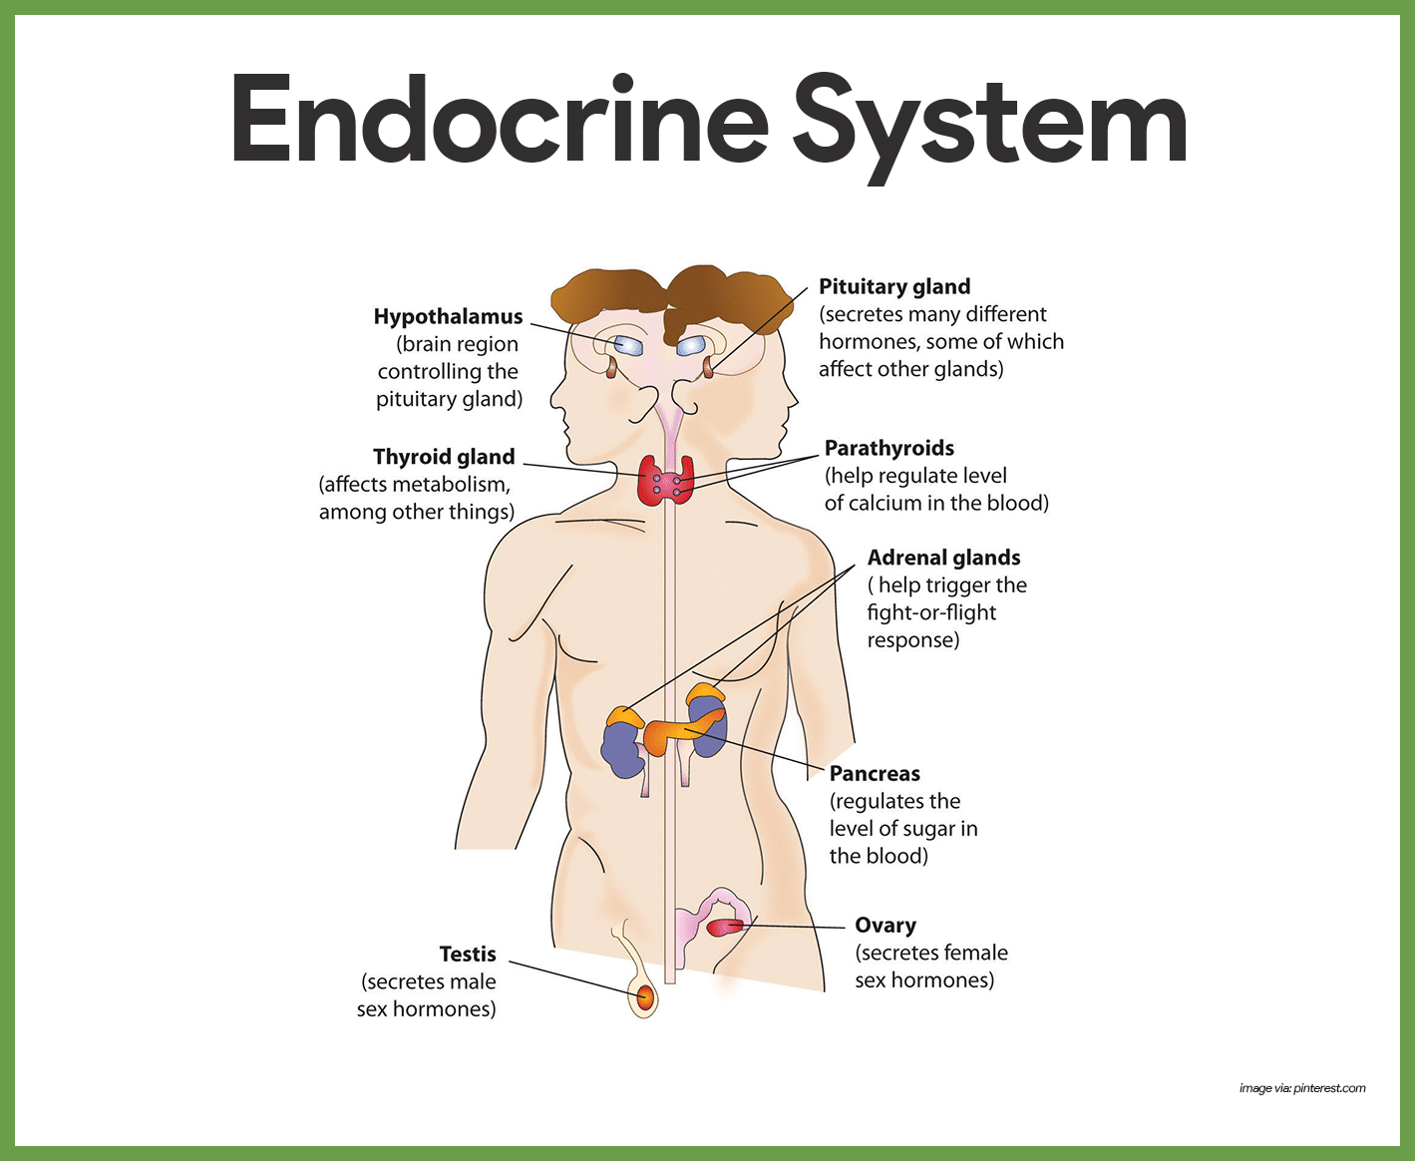
Lab 5: Endocrine System
Virtual Rat Exercise

Slide 2
Pre lab 5
1. Describe the relationship between the hypothalamus and the anterior pituitary gland. The hypothalamus is an important control center for regulating the release of hormones from the anterior pituitary gland. Releasing hormones, such as TRH, are released into the blood and travel through a specialized blood vessel to the anterior pituitary gland. There, TSH is secreted from the anterior pituitary gland and enters the blood system.
2. List the hormones released by the anterior pituitary gland. TSH, ACTH, LH, FSH, GH, and Prolactin
3. Why is the anterior pituitary gland called the master gland? It makes the hormones that are needed to stimulate hormone production around the body.
4. What is negative feedback? The bodies ability to reverse a change and return to homeostasis.
5. Describe the effects of thyroid hormone. The thyroid hormone regulates the growth of many body tissues and is important for CNS development. It increases your BMR and heat production.

Slide 3
Pre lab 5 (continued)
6. Describe the effects of cortisol. Promotes the breakdown of proteins and fats and helps the body deal with stress. It is also an immunosuppressive or anti-inflammatory agent.
7. Describe the effects of LH in males. LH stimulates the production of testosterone in the Leydig cells.
8. Describe the difference between hypertrophy and atrophy. Hypertrophy is enlargement from overactivation. Atrophy is a decrease in size from underuse.
9. Consider the differences between hyperthyroidism and hypothyroidism.
10. What are the effects of decreasing testosterone? Lower sperm count, hair loss, lower muscle mass and bone density.

Slide 4
Organ communication
Nervous system- “phone”
communication
Endocrine system- “Bulk Mail”

Slide 5
Glands and organs of the endocrine system
Gland | Hormone | Function
Pineal | Melatonin, only produced when you sleep at night | Tells you the time and season
 | TRH, ACTH, GnRH | Stimulates the production of synthesizing hormones
Posterior Pituitary | ADH(antidiuretic): hormone that holds onto fluids in our body | Water balance in body and kidney
Anterior Pituitary | Growth hormone TSH, ACTH, LH, FSH and others | Causes the cells to grow Signal production of other hormones
Thyroid | T3/T4 | Regulates metabolism
Parathyroid | PTH | Raises blood calcium
Pancreas | Insulin | Lowers blood sugar
 | Glucagon | Raises blood sugar
Adrenal Cortex | Glucocorticoids | Anti-inflammatory (like Advil)
Adrenal Medulla | Epinephrine (adrenaline) | Fight of flight
Ovary | Estrogen | Female sex characteristics
Testes | Testosterone | Male sex characteristics
Hypothalamus

Slide 6
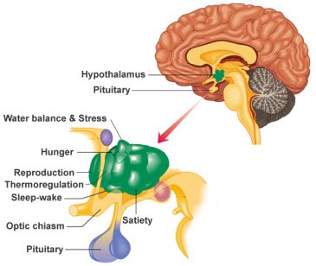
Hypothalamus and pituitary gland
Location in the brain and relation between hypothalamus and pituitary gland.

Slide 7
Hormone regulation
Hypothalamus releases “releasing hormones”
TRH, CRH, GnRH
The anterior pituitary gland then releases hormones that go to the appropriate gland or organ for production of the hormone needed.
ACTH, TSH, FSH, LH, GH, Prolactin
The pituitary gland releases hormones directly synthesized by the hypothalamus.
ADH, and oxytocin
TRH→ TSH→ Thyroid hormone
CRH→ ACTH→ Cortisol
GnRH→ LH→ Testosterone

Slide 8
Atrophy and hypertrophy
The adrenal gland on the left has atrophied from impeded use.
Possible causes: Addison’s disease, long-term corticosteroid therapy
This is a cross-section of a hypertrophied adrenal gland.
Possible causes: tumor from over stimulation from ACTH

Slide 9
Hormone Pathways
Homeostasis regulated mostly with negative feedback for hormones control.
If there is an excess of a hormone in the blood, negative feedback will shut off the production of that hormone. If this continues for a prolonged period it can lead to atrophy of the synthesizing gland.
If there is an excess of a hormone in the bloodstream the receiving gland will be overstimulated and eventually cause hypertrophy of that gland.

Slide 10
Post Lab
For your interest:
https://www.youtube.com/watch?v=eWHH9je2zG4

