Slide 1
Lab 4: Osmosis and Diffusion
Objectives:
Understand diffusion, osmosis, osmolarity, osmolality, semi- permeable membrane, tonicity, crenation, hemolysis.
What effects the permeability of a cell membrane

Slide 2
Pre-Lab
Choose the correct lettered answer (A, B, C or D) from below to complete each sentence:
1. Imagine you are placing cells in some solution.
If the solution is isotonic compared to the intracellular fluid (ICF), it ____C______.
If the solution is isosmotic compared to the intracellular fluid, it _____B_____.
If the solution is hypotonic compared to the intracellular fluid, it ____A______.
If the solution is hyposmotic compared to the intracellular fluid, it ___D_______.
A: will cause the cell to swell
B: contains the same concentration of total solute particles as the ICF
C: contains the same concentration of impermeant solutes as the ICF
D: contains a lower concentration of total solute particles than the ICF

Slide 3
Pre-Lab (Continued)
Sample calculations
1. How would you make a 30% (w/v) solution of glycerol?
Add 30g of glycerol and then fill to 100ml with distilled water.
2. What would the molarity of the above solution be? (The chemical formula for glycerol is C3H8O3.)
3.26 M
3. What is the osmolarity of the above solution?
3.26 Osm/L(glycerol does not disassociate in water)
4. What is the osmolarity of a 20% NaCl solution?
6.90 Osm/L
5. Assuming that these solutes are impermeant, is the 30% solution of glycerol hypertonic, hypotonic, or isotonic to the 20% solution of NaCl?
Technically it would be hypo-osmotic since we can compare their osmolarities it is no longer a relative measure.

Slide 4
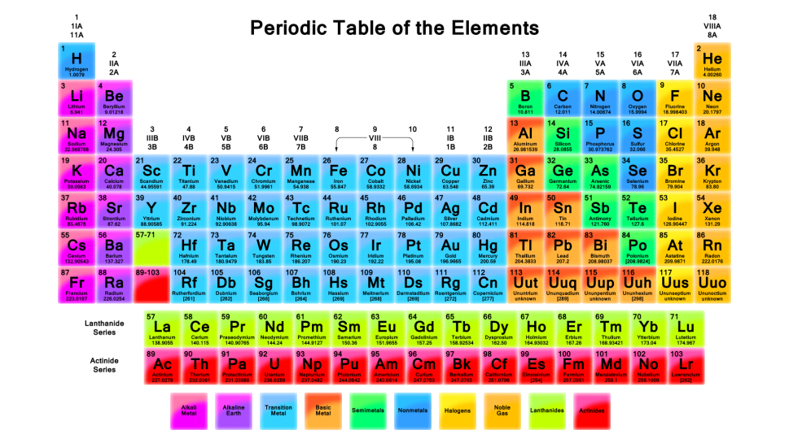
Vocabulary
Making a Solution
Molarity
How do you make an 11% sucrose solution?
molarity = # of moles of solute
1 liter of solution
Mass of one mole = the molecular weight of the substance in grams
Add 11 grams of sucrose to a beaker and then fill to 100 ml.

Slide 5
Osmolarity
Osmolality
osmolarity = # of osmoles of solute
1 liter of solution
# of osmoles = the # of moles times the number of particles that the substance breaks into when put into solution.
Example: NaCl breaks (ionizes) into Na+ and Cl- (2 particles) when put into water.
osmolality = # of osmoles of solute
1 Kg water
* Not significantly different from osmolarity, just know that there is a difference.

Slide 6
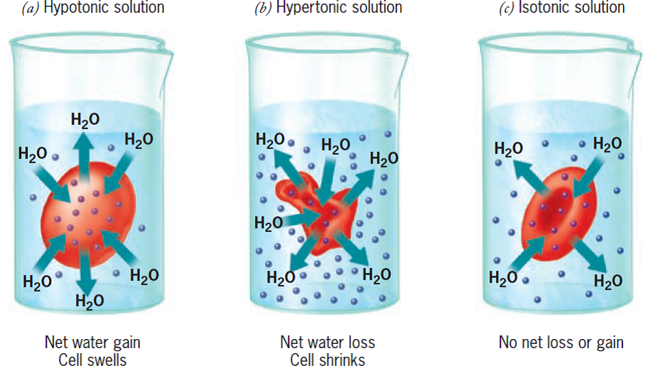
Tonicity The ability of solutions to pull water across a membrane

Slide 7
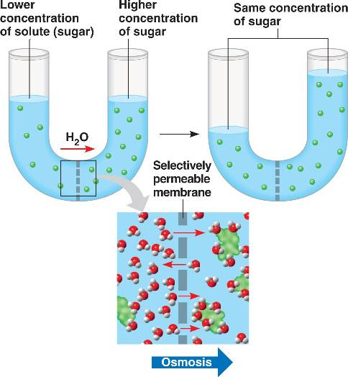
Tonicity is a relative measure
Hypotonic =low concentration of solutes
Hypertonic = high concentration of solutes
Isotonic= equal concentration of solutes
*Water is always moving across the membrane, but there is not always a NET movement.

Slide 8
Diffusion
The movement of particles from regions of high concentration to low concentration.
Diffusion of water = Osmosis
Diffusion of particles= Dialysis

Slide 9
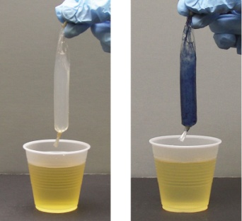
Lab Procedure
Activity 1:
A. Selective permeability and osmosis
Three thistle tubes are filled with 15% sucrose solution, 30% sucrose solution and distilled water. Data has been recorded over a 90 minute period. Copy Data from the board. Match the solutions to the labels. Graph Results.
B. Dialysis across a Semi-permeable Membrane
Tubing filled with starch, beaker filled with iodine.
What do you predict to happen after some time passes?
C. Red Blood Cells as Osmometers
Make a stock blood solution (Dilute blood) mix with three different solutions distilled water, 0.9% NaCl, 2.0% NaCl. Immediatley place in front of a printed page and determine wether solution is clear or cloudy.
Cloudy= hypertonic
Clear= hypotonic (Cells have lysed or burst)
Repeat after 5 minutes (Complete procedures 1-4)
https://www.youtube.com/watch?v=A8cI6FkcG4c

Slide 10
Lab Procedure
Activity 1:
A. Selective permeability and osmosis
Solution A-15% Sucrose
Solution B- 30% Sucrose
Solution C-Distilled Water (Isotonic)
B. Dialysis across a Semi-permeable Membrane
What do you predict to happen after some time passes?
Iodine passes into the dialysis tubing and the solution turns blue.
C. Red Blood Cells as Osmometers
Tube A- Hypotonic to cell (hemolyse)
Tube B- Isotonic to cell
Tube C-Hypertonic to cell (Crenate)

Slide 11
Bonus Questions!!
Answer questions in your group and make sure to get them checked off before you leave for participation points today!
1.What is the osmolarity of a 3 molar NaCl solution?
2. What is the molarity of a solution made by dissolving 22.5g of Mg(NO3)2 in enough water to make 450 mL of solution?
3. Calculate the volume, in liters, of a 3.0M NaOH solution containing 0.456 mol of NaOH
4. What is the osmolarity of each of the following solutions?
a)0.25 M NaBr b) 0.15 M Na2SO4

Slide 12
Post Lab

