Slide 1
Lab 3: Enzymatic Digestion
Objectives:
Understand and be able to label positive and negative controls
Which enzymes digest the three major nutrients (carbohydrates, lipids, and protein)
What effects enzyme activity
Be able to describe expected results when similar experiments are presented.

Slide 2
Pre-Lab
1. What would you predict the optimal temperature to be for these enzymes that work in the human body?
98.7◦ F
2. What would you predict the optimal pH to be for pepsin; for the other enzymes? Why the difference?
Pepsin-pH2 ; Other Enzymes pH9
3.What is the difference between mechanical digestion and chemical digestion?
See slide 4
4. What substances would be present in a positive control tube? Predict the results of the assays for the substrate and for the product in a positive control tube after incubation.
Positive control has a substrate, enzyme and ideal conditions; see slide 3
5. What substances would be absent in a negative control tube? Predict the results of the assays for the substrate and for the product in a negative control tube.
The substrate or enzyme would be left out in a negative control; see slide 3

Slide 3
Experimental Protocol Tubes
Type of Digestion→ Tube Contents | Protein Digestion | Lipid Digestion | Carbohydrate Digestion
Substrate (Reactant) | Albumin | Olive Oil | Starch
Enzyme | Trypsin | Pancreatic Lipase | Amylase
Expected Product | Amino Acids | Glycerol & fatty acids | Maltose
Assay for Substrate | Biuret test + violet -/+ pink | pH test + decrease in pH - No pH change | Iodine Test +blue/black - brown/yellow
Assay for Product | Ninhydrin test + blue/violet -colorless |  | Benedict’s test + red/orange +/- yellow/green - blue

Slide 4
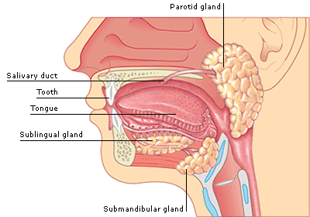
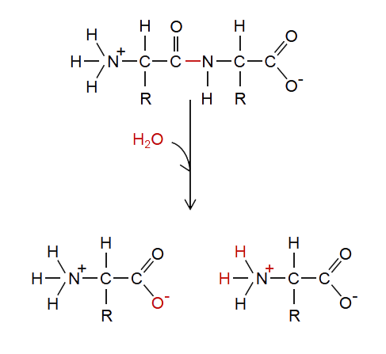
Vocabulary
Mechanical Digestion-
chewing, mixing, and peristalsis
Chemical Digestion-
Special enzymes
Hydrolysis- water is
Added to help the
breakdown of larger
food molecules into monomers

Slide 5
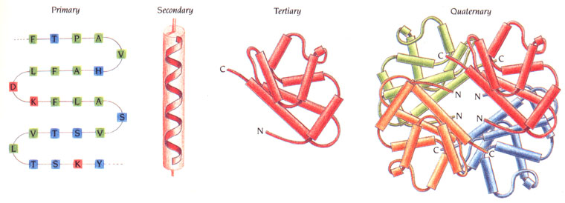
Activity 1:Protein Digestion
Stomach (pH 2)
Small Intestine (pH 9)
Protein (Albumin)+ → Amino Acids + Trypsin &
Chymotrypsin → Amino Acids + amino peptidases & dipeptidases →
Amino Acids
[Absorbed into the ]

Slide 6
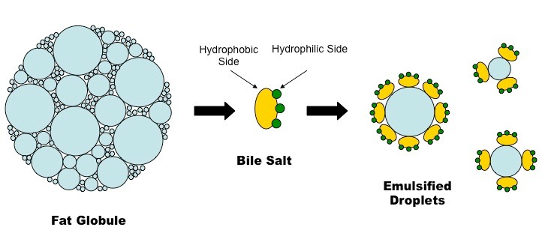
Activity 2: Lipid Digestion
Lipid+ bile salts (produced in , stored in gall bladder,
released in small intestine) → + lipase→ glycerol & fatty acids
[Absorbed in the lacteals of the small intestine]
pH Test: If digestion has occurred the pH will .

Slide 7
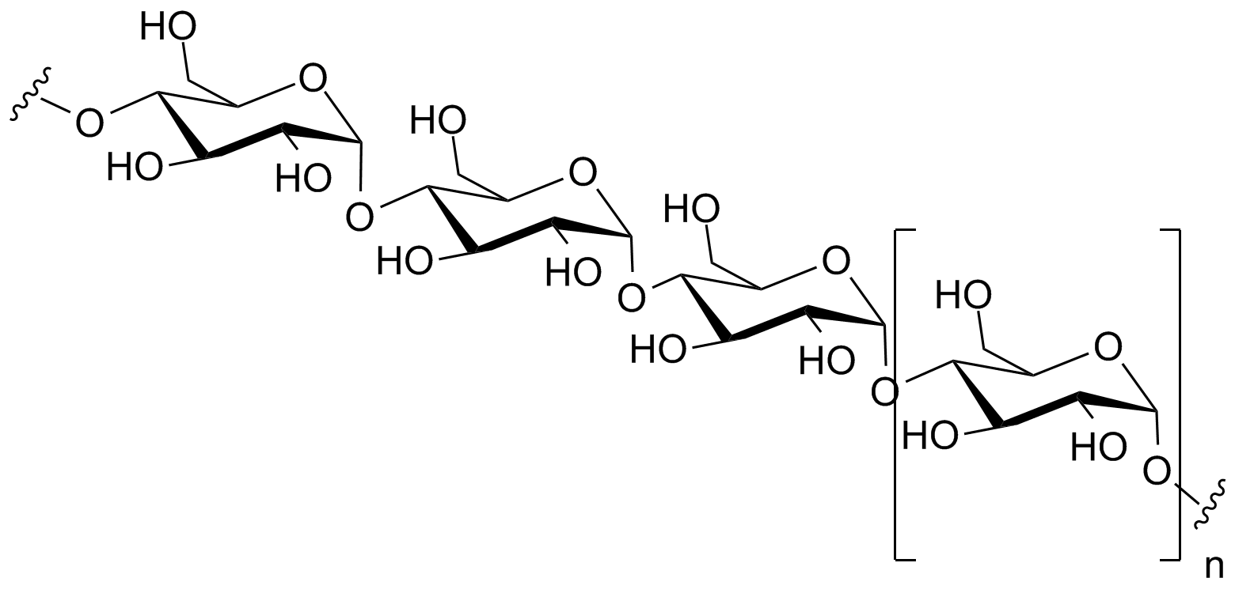
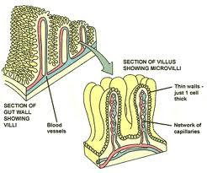
Activity 3: Carbohydrate Digestion
Starch + → Maltose (disaccharide) +
maltase → glucose (monosaccharide)
[Absorbed in the capillaries of the .]
Salivary (mouth pH )/Pancreatic (Pancreas)
Brush border of S. I.
Brush border of S.I.

Slide 8
Things to Consider…
Variables we are testing:
Effects of pH change on enzyme function
How does boiling an enzyme effect function?
What is a positive control?
What is a negative control?
Why are we incubating the test tubes at 37◦c?

Slide 9
Post Lab

