Slide 1
Lab 2: Data Analysis: Statistics, Graphing, Standard Curves
Objectives:
Calculate and understand mean, median, mode, Range and standard deviation
Learn the difference between accuracy and precision
Learn how to input formulas and graph in excel

Slide 2
Pre-Lab
1. In popular usage, the term average most often refers to
a. the mean.
b. the median.
c. the mode.
d. the range.
e. all of these
2. A researcher measured the forced vital capacity (take as big a breath as you can and then exhale as much air as fast as you can) of patients with asthma in a study investigating the efficacy of a new asthma drug. The researcher recorded the following forced vital capacities in liters: 1, 7, 3, 3, 6, 4.
The mean and median for this data are
a. 4 and 3.
b. 4.8 and 3.5.
c. 4 and 3.33.
d. 4.8 and 3.
e. 4 and 3.5.
3. Which of the following measures tends to be most influenced by an extreme value?
a. median b. mode c. mean
4. What do the letters BMI stand for? How do you determine the percent body fat for an individual? What is the BMI for a woman who is 5 foot 3 inches tall and weighs 130 pounds?
Body Mass Index, BIA Scale, 23
5. Define absorbance and transmittance. Describe how these two terms are related to each other.
Absorbance=the ability for a solution to absorb light. Transmittance= the % of light that is not absorbed or bounces back.
6. The concentration of a solution is directly proportional to its __absorbance__ as measured with a spectrophotometer.
7. What is the purpose of the biuret reagent in the spectrophotometry activity? Changing the color of the solution directly proportional to the concentration of proteins in the solution.

Slide 3
Activity 1: Calculating the Mean, Median, Mode, Range and Standard Deviation
Researchers investigating the causes of death in persons with asthma recorded the heart rates of 10 asthma patients on admission to the hospital.
1. Calculate the mean heart rate for the patients.
167+150+125+120+150+150+40+136+12+150=
1308/10=130.8
2. Calculate the median heart rate for the patients.
Median = _143__
3. Calculate the mode.
Mode = __150__
4. Calculate the range.
Range = __40-167=127__
Patient | Heart Rate
1 | 167
2 | 150
3 | 125
4 | 120
5 | 150
6 | 150
7 | 40
8 | 136
9 | 120
10 | 150

Slide 4
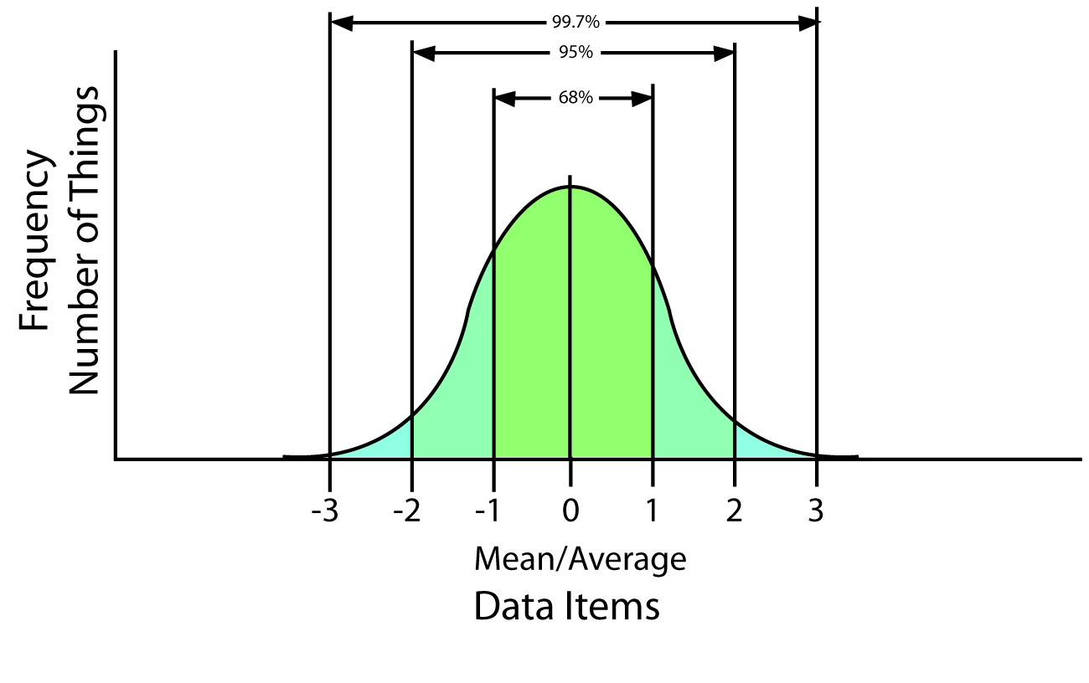
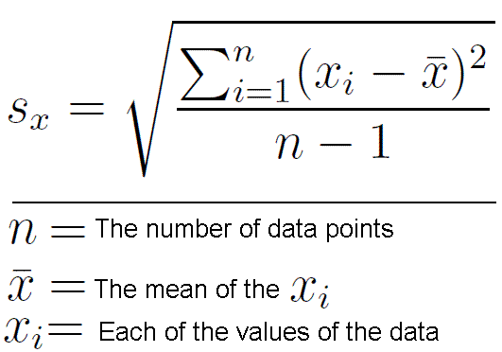
Standard Deviation

Slide 5
Standard Deviation
Data Value (xi) Heart Rate | Data Value-Mean (xi-x) | (xi-x)²
167 | 36 | 1296
150 | 19 | 361
125 | 6 | 36
120 | 11 | 121
150 | 19 | 361
150 | 19 | 361
40 | 91 | 8281
136 | 5 | 25
120 | 11 | 121
150 | 19 | 361
Patient | Heart Rate
1 | 167
2 | 150
3 | 125
4 | 120
5 | 150
6 | 150
7 | 40
8 | 136
9 | 120
10 | 150
Sum=√11,324/9
=35.47

Slide 6
So what does this mean?
Standard Deviation=35

Slide 7
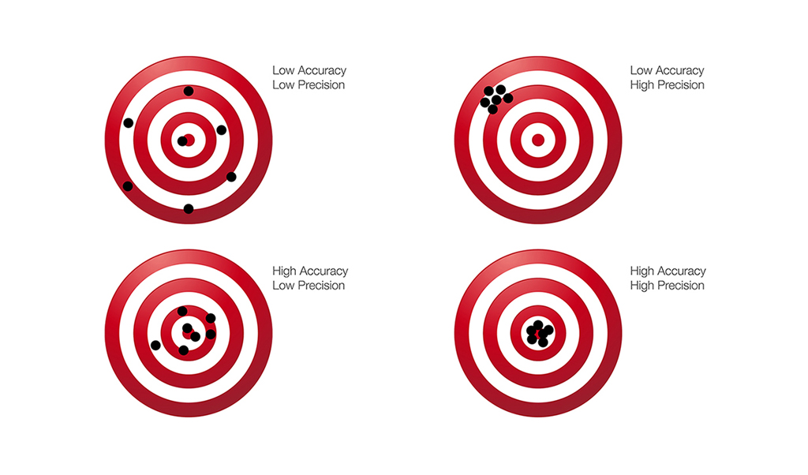
Accuracy vs Precision

Slide 8
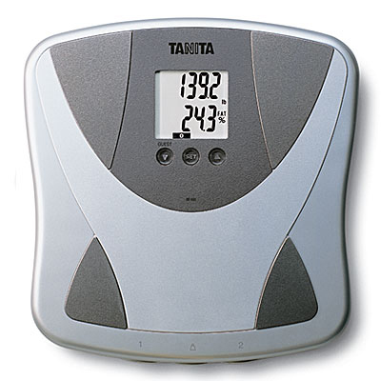
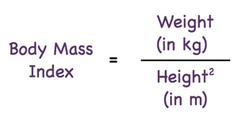
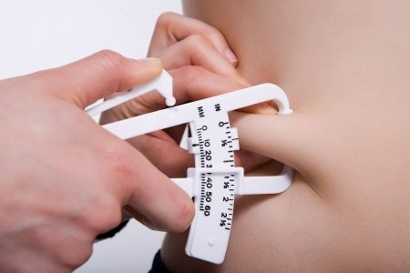
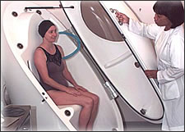
Percent Body Fat
BIA Scale
Calculated % body fat from BMI
Air/water displacement
Skin calipers

Slide 9
Post lab

