Slide 1
Lab 10: Renal Function
Urine Characteristics
Disease types
Flow through nephron

Slide 2
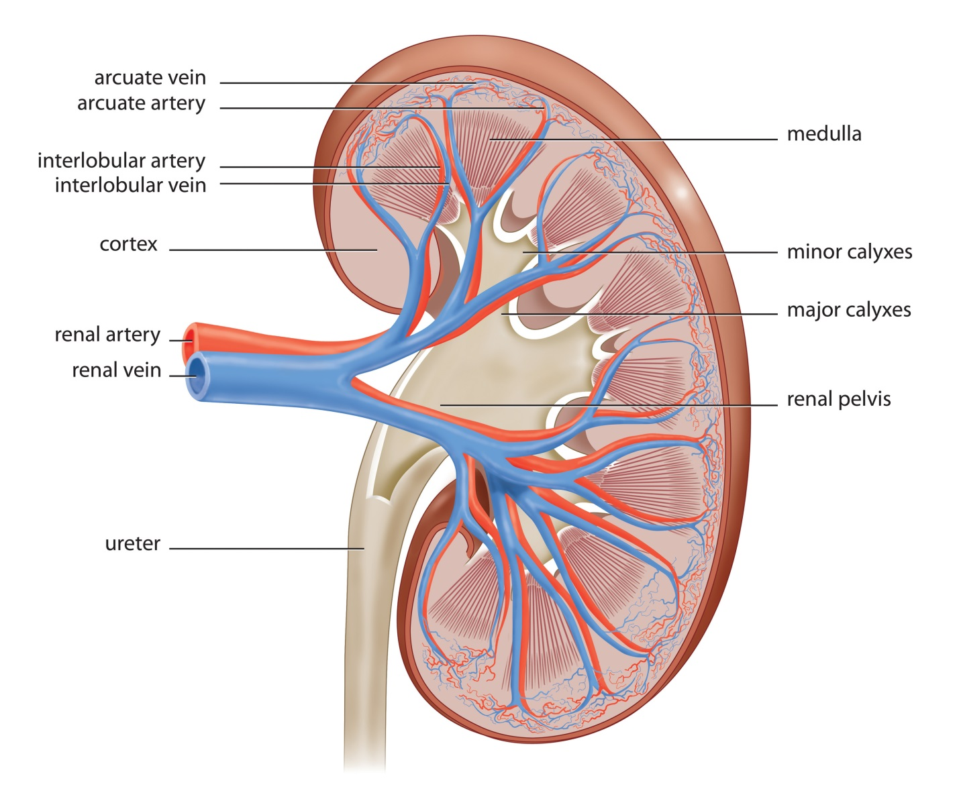
Anatomy of the Kidney
1 million nephrons
Total plasma volume filtered 60 times a day

Slide 3
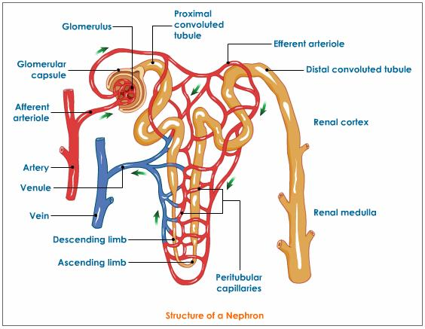
Nephron
Glomerulus→ Glomerular Capsule → U shaped tubule→ Collecting Duct

Slide 4
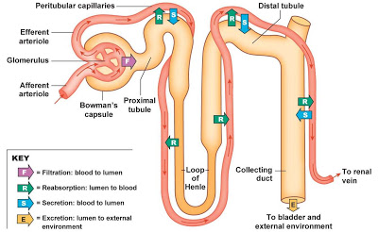
Kidney Functions
Filtration
Secretion
Reabsorption
Erythropoiesis

Slide 5
Characteristics of Urine
Yellow/Clear color
Aromatic Odor
pH______
Specific gravity _______
Waste Chemicals- Urea, creatinine, uric acid, ketone bodies, salts(ie: NaCl)

Slide 6
Abnormal Conditions
Albuminuria- protein in the urine
Glucosuria- Glucose in the urine (Diabetes)
Hematuria- RBC’s in the urine (kidney trauma)
Pyuria-WBC’s in the urine (infection)
Ketosis- High ketone bodies

Slide 7
Post Lab

