Slide 1
LAB:10
RENAL FUNCTION

Slide 2
OBJECTIVES
ANATOMY OF THE KIDNEY
FUNCTIONS OF THE KIDNEY
NORMAL AND ABNORMAL CONSTITUENTS OF URINE

Slide 3
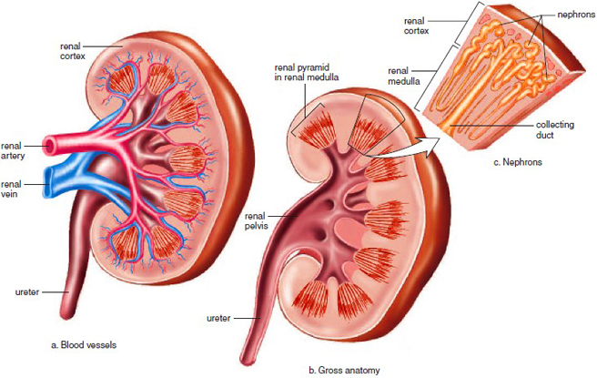
ANATOMY OF THE KIDNEY

Slide 4
FUNCTIONS OF THE KIDNEY
Regulation of plasma ionic composition
Regulation of plasma volume and blood pressure
Regulation of plasma osmolarity
Regulation of plasma hydrogen ion concentration (pH)
Removal of metabolic waste products and foreign substances from the plasma
* It also performs secondary functions

Slide 5
FUNCTIONS OF THE KIDNEY
Nephron is the functional unit of the kidney.
Three exchange processes occur within the renal nephrons
1. Filtration
2. Reabsorption
3. Secretion

Slide 6
FUNCTIONS OF THE KIDNEY
Filtration: This occurs from the glomerular capillaries into the Bowman’s capsule.
This is where pretty much everything is filtered out of the blood plasma with the exception of RBC’s, WBC’s, platelets and most plasma proteins.
Reabsorption: This occurs from the tubules into the peritubular capillaries.
Many plasma components that are filtered in the kidneys are still useful for body functions, and, thus are reabsorbed back into the blood (Na+, K+, Ca2+, water, glucose, amino acids, etc.)

Slide 7
FUNCTIONS OF THE KIDNEY
Secretion: This occurs from the peritubular capillaries into the tubules.
Secretion follows the same basic processes as reabsorption and involves the same barriers, except that movement goes in the reverse direction. Substances actively secreted by the renal tubules are ions, waste products and foreign substances.

