Slide 1
Lab 11: Pulmonary Ventilation
Objectives:
Stages of respiration
Factors that influence diffusion rate
Different volumes and intervals on a spirogram

Slide 2
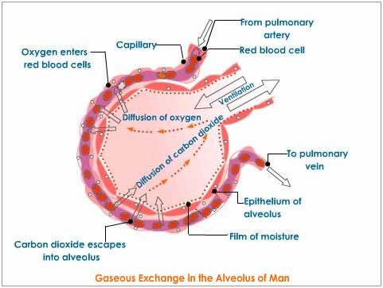
5 Stages of Respiration
Respiration
how the body obtains and uses oxygen and eliminates CO₂
Pulmonary Ventilation
Lungs Environment
Pulmonary gas exchange
Lungs Blood Stream
Gas transport
Within bloodstream
Tissue/blood gas exchange
Bloodstream Tissues
Cellular Respiration
Consumption of oxygen and production of CO₂

Slide 3
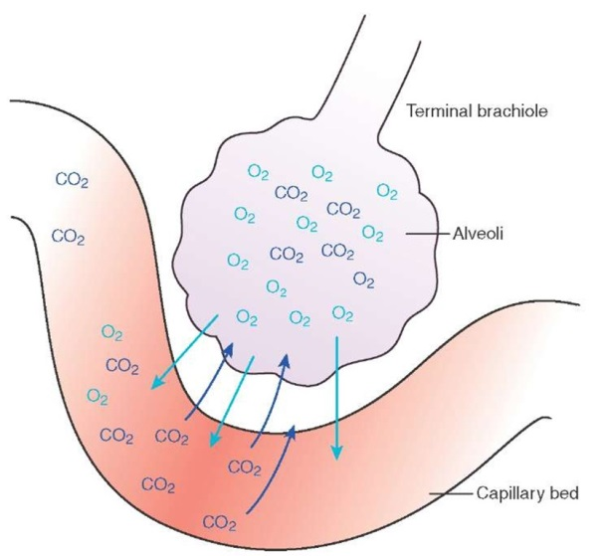
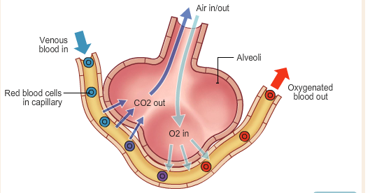
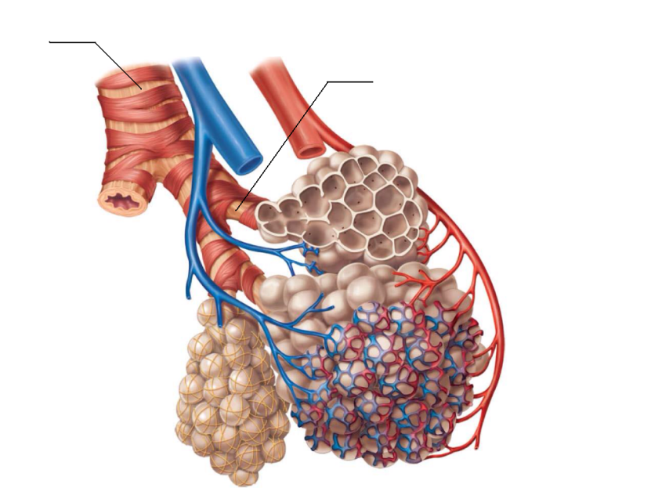
Rate of Diffusion
Main factors that influence diffusion:
Diffusion distance, surface area and concentration gradient

Slide 4
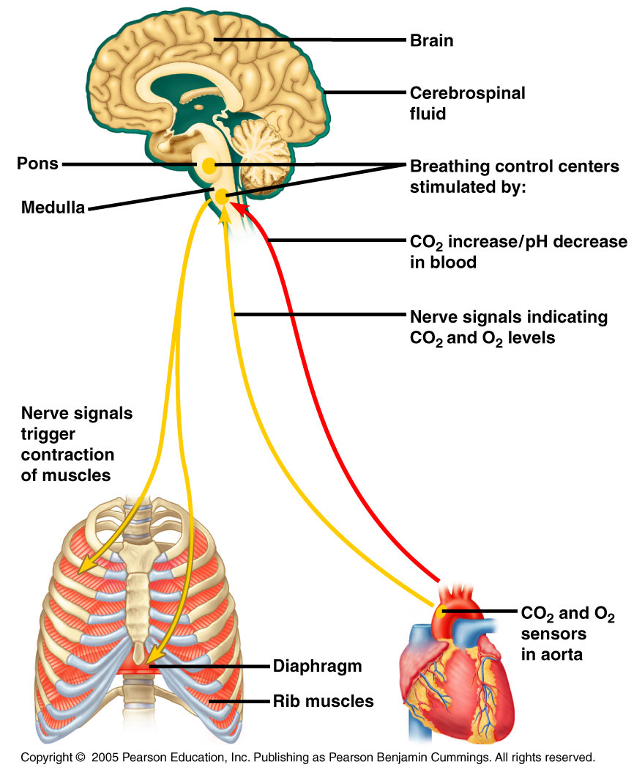
Regulation of Co₂ and O₂ levels

Slide 5
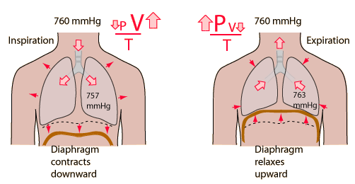
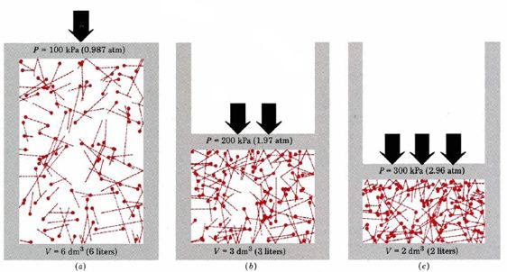
Volume and Pressure
https://www.youtube.com/watch?v=mhiPrjcC7Kk

Slide 6
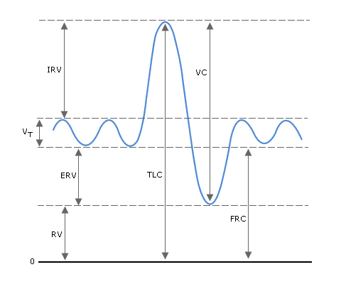
Spirogram of lung volumes and Capacities
Tidal Volume (TV): The volume of air inspired (or expired) during normal relaxed ventilation.
Inspiratory Reserve Volume (IRV): The volume of air that may be forcibly inspired above the normal inspired tidal volume
Expiratory Reserve Volume (ERV): The volume of air that may be forcibly expelled following normal expired tidal volume
Vital Capacity (VC): The volume of air expired from maximal inspiration to maximal expiration.
VC = IRV + TV + ERV
Residual Volume (RV): The volume of air remaining in the lungs following maximal forceful expiration.
Total Lung Capacity (Volume) (TLC)= IRV + TV + ERV + RV or TLC= VC + RV
Functional Residual Capacity (FRC): The amount of air left in the lung after a normal expiration.
FRC = RV + ERV or FRC = TLC - RV

Slide 7
Post Lab

