Slide 1
WEEK 1

Slide 2
OBJECTIVES
LAB SYLLABUS
INTRODUCTION TO THE COURSE CANVAS SITE
SAFETY RULES
LAB #1: HOMEOSTASIS, DATA COLLECTION, AND DATA ANALYSIS

Slide 3
LAB SYLLABUS
COPY OF SYLLABUS HERE

Slide 4
LAB CANVAS SITE
SYLLABUS
QUIZZES
ASSIGNMENTS
GRADES

Slide 5
LAB SAFETY RULES
IN THE LAB MANUAL. PAGE 0.2

Slide 6
LAB #1
HOMEOSTASIS, DATA COLLECTION, AND DATA ANALYSIS

Slide 7
OBJECTIVES:
HOMEOSTASIS
NEGATIVE AND POSITIVE FEEDBACK
REPRESENTING DATA COLLECTION IN A GRAPH
FALLACIOUS REASONING
CIRCADIAN RHYTHMS

Slide 8
HOMEOSTASIS
Homeostasis is the body’s ability to maintain measurable variables within a set range. Examples of measurable variables mentioned in the lab manual include cardiac output, blood pressure, body temperature, blood pH, and blood glucose.
Set range
expected value - Examples
Core body temperature = 37º C
Blood glucose (sugar) = 100 mg/dL
Blood pH = 7.4
To maintain a regulated variable within the set range, the body uses different mechanisms, which includes receptors, integrating center, effectors and signals.
Negative mechanisms function to minimize change in the variable. Negative feedback consists of. Example of negative feedback is body temperature. When your body temperature changes----- the sensors in the hypothalamus respond to those changes by stimulating sweat glands to change the temperature or signaling skeletal muscle---- the integrating center will also send messages to the smooth muscle of peripheral blood vessels to either increase/decrease blood flow to the skin----effectors will act to increase/decrease body temperature.

Slide 9
HOMEOSTASIS: Negative Feedback

Slide 10
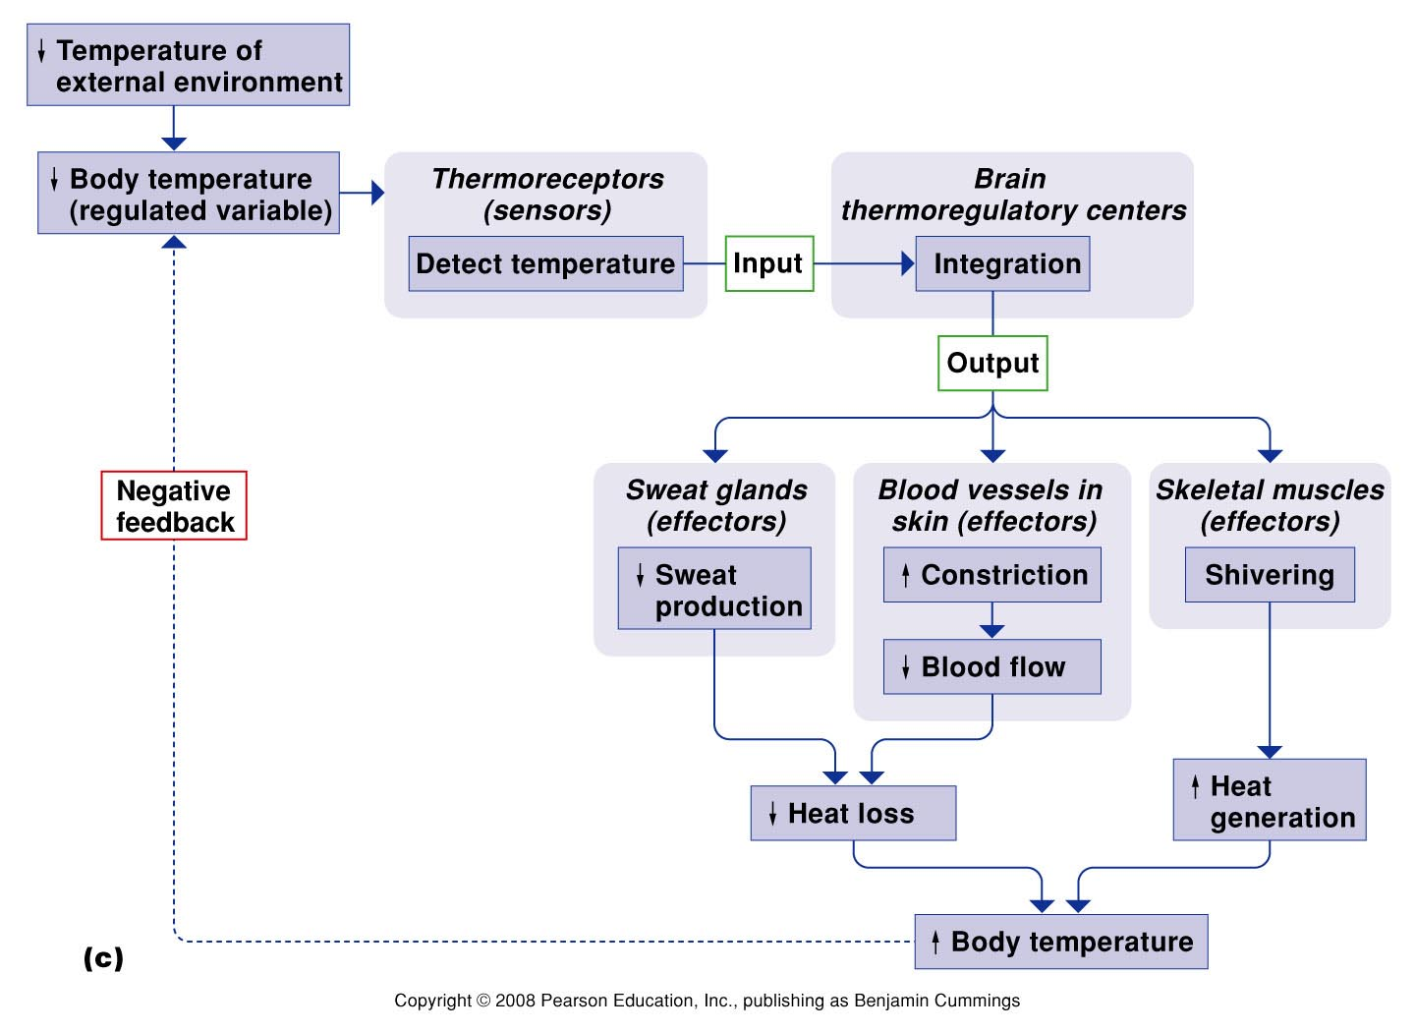
Negative Feedback Example: Thermoregulation
Core body temperature
Humans: 37º C (98.6º F)
Hypothermia = decrease in body temperature
Hyperthermia = increase in body temperature
Above 41º C is dangerous
Above 43º C is deadly

Slide 11
HOMEOSTASIS: Positive Feedback
Positive feedback are mechanisms that are use to push levels further out of normal ranges. Positive feedback mechanisms accelerate the output created by the stimulus.
Example of positive feedback is the control of estrogen secretion. The pituitary gland secretes a hormone, LH, which stimulates estrogen secretion, which stimulates LH release, which stimulates more estrogen secretion, and so on.
There are some factors that can terminate the positive feedback by either removing the original stimulus or if a second system interrupts it.

Slide 12
HOMEOSTASIS: Positive Feedback

Slide 13
Positive Feedback Example

Slide 14
REPRESENTING DATA COLLECTION IN A GRAPH
Graphs are use to have a visual representation of the collected data and to make analyzing data much easier.
When creating a graph, two variables are involved.
Independent variable (x-axis): is the experimental condition controlled by the scientist.
Dependent variable (y-axis): is the variable the scientist is trying to learn about.

Slide 15
REPRESENTING DATA COLLECTION IN A GRAPH
A graph needs to have:
Title
Date
Labels for each of the axes including units
Final step of data collection is analyzing the graph looking for any relationships between the variables.

Slide 16
FALLACIOUS REASONING
Fallacious reasoning refers to a conclusion an individual draws that is not supported by evidence.
One should avoid this by performing well controlled experiments with testable predictions (Occam’s razor – begin with the simplest explanation for any situation)
Correlation is not causation.
MUST READ TWO RESEARCH PAPERS

Slide 17
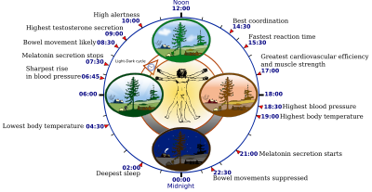
CIRCADIAN RHYTHM
The internal body clock.
It is affected by environmental cues.

Slide 18
MOVIES ABOUT CIRCADIAN RHYTHM
http://www.youtube.com/watch?v=UbQ0RxQu2gM
http://www.youtube.com/watch?v=nzUds0TIQMY

Slide 19
HOMEWORK
Collecting Data
Record and track (3 day period)
- pulse rate
- body temperature
- reaction time
Circadian Rhythm Worksheet (6 day period)

