Slide 1
Lab 1: Homeostasis, Data Collection and Data Analysis
Objectives:
Define Homeostasis
Understand the different feedback mechanisms that maintain homeostasis
Understand the differences and similarities between causation, correlation and fallacious reasoning
Understand the concept of circadian rhythm

Slide 2
Pre-Lab
1. What is the term used to describe the body’s ability to maintain measurable variables within a healthy range?
Homeostasis
2. List some human physiological variables that are maintained within a narrow normal range.
Blood pressure, temperature, heart rate, blood glucose levels
3. An elevated blood pressure is detected in the arteries, and the body’s response is to slow the heart rate. Does this represent a positive or negative feedback mechanism?
Negative
4. An action potential begins when a few very sensitive voltage-gated sodium channels open. These open channels sodium to diffuse into the cell, causing the membrane potential to become less negative. The change in membrane potential causes even more voltage-gated sodium channels to open, allowing even more sodium to diffuse into the cell and causing the membrane potential to become even less negative. This is an example of which type of regulatory mechanism?
Positive
5. If time is one of the variables used in an experiment, the scientist usually decides at which time points he/she wants to take measurements of the other variable. Because time is used in this manner in experimental protocols, it is considered the __independent__ variable and is always plotted on the __X__ axis.

Slide 3
Pre-Lab (Continued)
6. When one reaches a conclusion by using incorrect reasoning methods, this is known as a fallacious reasoning.
7. If two variables, such as caloric intake and human height, fluctuate together, can one infer correlation, causation, or both?
Correlation
8. Which parts of the brain are most directly involved in regulating circadian rhythms?
Hypothalamus (suprachiasmatic nucleus)
Pineal gland (Melatonin)
9. Name some human biological rhythms which often vary dependably over a 24-25 hour cycle.
Temperature, alertness, reaction time, bowel movements and blood pressure
10. Match each of the following terms with its correct definition.
GIP __D__ A. hormone secreted by the adrenal medulla in response to stress
or excitation
oxytocin __C__ B. hormone secreted by the pancreas in response to high blood
glucose levels. Lowers blood glucose by stimulating cells to
take in glucose
thrombin ___E___ C. hormone that stimulates uterine contractions during labor
epinephrine __A__ D. hormone secreted by the small intestines that stimulates insulin
secretion in anticipation of rising blood glucose levels
insulin __B__ E. clotting factor that stimulates the formation of fibrin, which
forms the blood clot
melatonin ___F___ F. hormone secreted by the pineal gland that is involved in

Slide 4
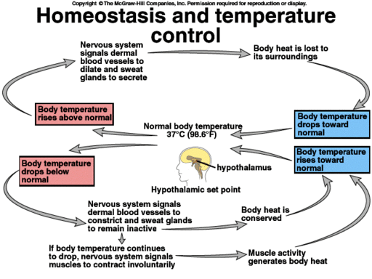
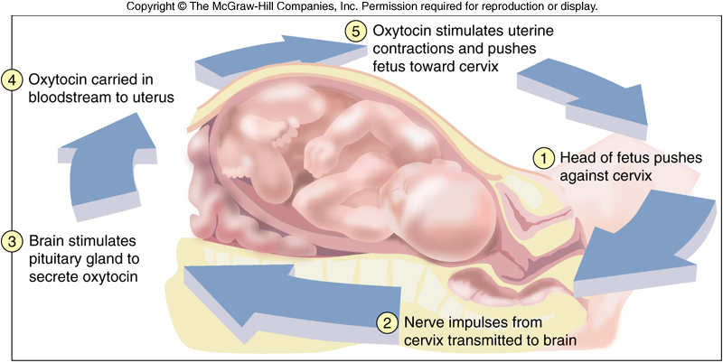
Activity 1: Homeostasis
The body’s ability to maintain measureable variables within a healthy range.
Negative Feedback
Positive Feedback

Slide 5
Negative Feedback Reverses a change to return the variable to a normal range

Slide 6
Positive Feedback Accelerates or enhances an output to create change
https://www.youtube.com/watch?time_continue=530&v=_xh9l2oRHzY

Slide 7
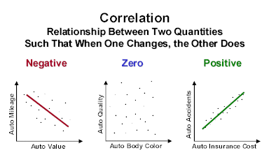
Activity 2: Graphically Representing Changing Conditions
Negative Correlation
Positive Correlation
No Correlation
Y- Dependent Variable
X- Independent Variable

Slide 8
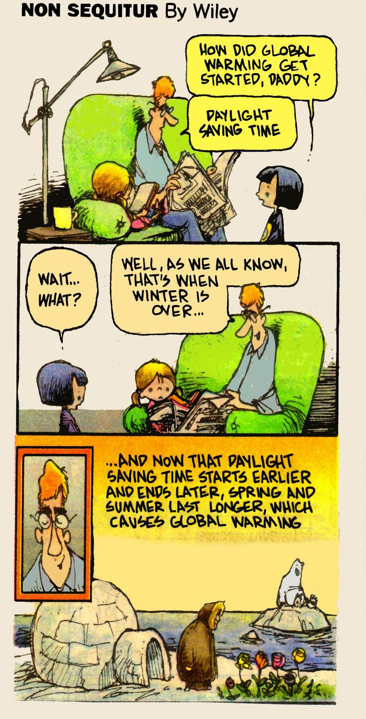
Activity 3: Fallacious Reasoning
Avoid:
Extraordinary Claims
Propaganda media
Turning correlation into causation

Slide 9
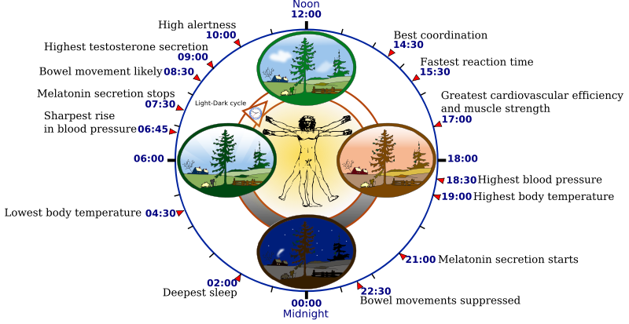
Activity 4:Circadian Rhythm
https://www.youtube.com/watch?v=UbQ0RxQu2gM&authuser=0

Slide 10
Circadian Rhythm Assignment
Circadian Rhythm Worksheet
Day 1
Bedtime:
Rise Time:
Disruptions:
Total Sleep Time: [Round DOWN on this number – to the nearest half hour - because it is common to not technically “sleep” for a period of time after you get in bed and before you wake up
Slump Time: [both time of day and total hours “slumped”]
Day 2
Bedtime:
Rise Time:
Disruptions:
Total Sleep Time:
Slump Time:
Day 3
Bedtime:
Rise Time:
Disruptions:
Total Sleep Time:
Slump Time:
Overall Comments on Your Sleep/Wake Cycle and Slump Time:

Slide 11
Post Lab

